Slide 1
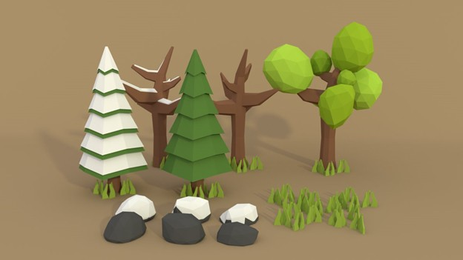
LOW POLY (SIN TEXTURAS)
https://pre00.deviantart.net/642d/th/pre/f/2014/122/1/a/low_poly_forest_by_a_l_o_c_i_n-d7gusvt.png

Slide 2
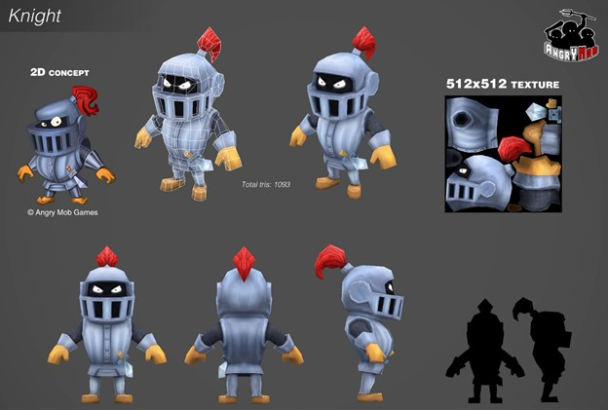
LOW POLY
https://cdna.artstation.com/p/assets/images/images/000/324/682/large/rodrigo-goncalves-knight.jpg?1417141223

Slide 3
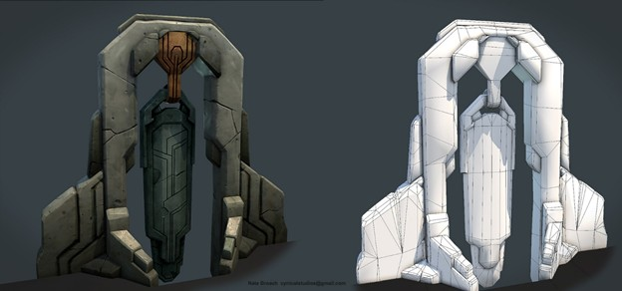
STYLIZED CARTOON
https://cdnb.artstation.com/p/assets/images/images/002/911/053/large/nate-broach-gong.jpg?1467165773

Slide 4
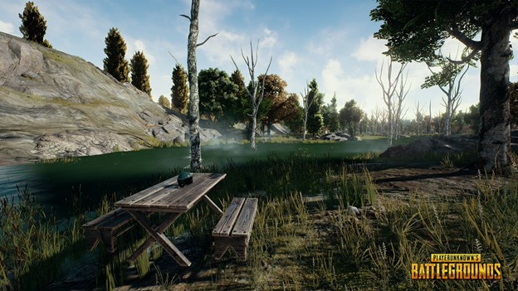
REALISTIC
https://www.pubg.com/es/

Slide 5
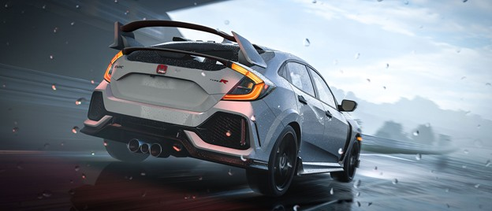
HYPERREALISM
http://compass.xboxlive.com/assets/b0/f7/b0f7a29c-36a5-4c35-8225-825444661547.jpg?n=FM7_MayUpdate_carousel.jpg

